Slide 1
Bach: 6 Violin Sonatas and Partitas for Solo Violin (BWV 1001 – 1006)
Akira Wang – 913319

Slide 2
Short Biography of Bach
Lived between 31st March 1685 – 28th July 1750
Born in Eisenach and died in Leipzig
Notes:
Bach was born in Eisenach on the 31st of March 1685 and passed away in Leipzig on the 28th of July 1750. I will be mainly covering the time he spent in Cothen during 1717 to 1723.
Cothen = Curtain

Slide 3
Bach in Cothen (1717 – 1723)
Friends with Prince Leopold
Prince Leopold was proficient on the harpsichord, violin and the violin da gamba
Whenever the Prince travelled, Bach and members of his orchestra would accompany him
The 2 trips were to Karlsbad in 1717 and 1720, where upon his return in 1720 he found out that his wife had passed away
Notes:
During his time in Cothen, Bach became friends with Prince Leopold who was proficient on the harpsichord, violin, viola da gamba and occasionally performed with the court musicians (contrary to court etiquette).
Whenever Prince Leopold travelled, Bach and selected members of his orchestra would accompany him (to Karlsbad in 1718 and 1720).
On his return back in 1720, he found out of his wife’s death.
Cothen = Curtain
Leopold = Leo-pole-d
Karlsbad = Carl-s-bad

Slide 4
The Violinist Bach???
Although renowned as one of the best organist, Bach was also a fine violinist
His father and grandfather were successful violinists
Bach’s first ever professional post was as a court violinist in the chamber orchestra of Duke Ernst of Weimar
Notes:
It is often wondered how Bach who was renowned as one of the best organists, could have written such compositions for the violin in such complex ways.
But in fact, Bach was in his own right a violinist but only overshadowed by his own fame.
He had a strong background in violin – Both his father and grandfather were successful violinists and actually, his first professional post was as a court violinist in the chamber orchestra of Duke Ernst of Weimar.
Weimar = Vy-mar

Slide 5
The Journey of the Manuscript
Composed in 1720 (approx. 3 months following the death of his wife)
The original autograph manuscript (along with the solo cello suites) were passed through:
Anna Magdalena
J. C. F Bach
Christina Louisa Bach
The first printed edition (with many errors) were published in 1802 by Nikolaus Simrock
Notes:
The autograph manuscript along with the copy of the solo cello suites were passed into the possession through his second wife Anna Magdalena and then inherited by J. C. F. Bach who finally passed it onto his sister Christina Louisa Bach.
There are also four other manuscripts distributed in which one was owned by the violinist Pisendel.
The first edition was printed in 1802 by Nikolaus Simrock. However, it was still largely ignored until the violinist Joseph Joachim performed these works.
Joseph Joachim = Yo-seph Yo-a-kim

Slide 6
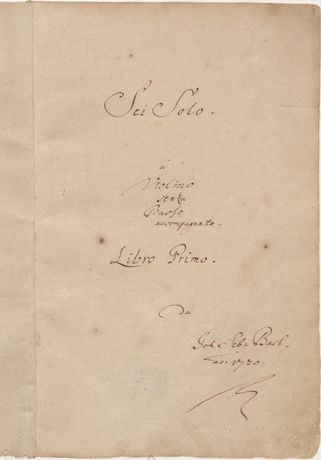
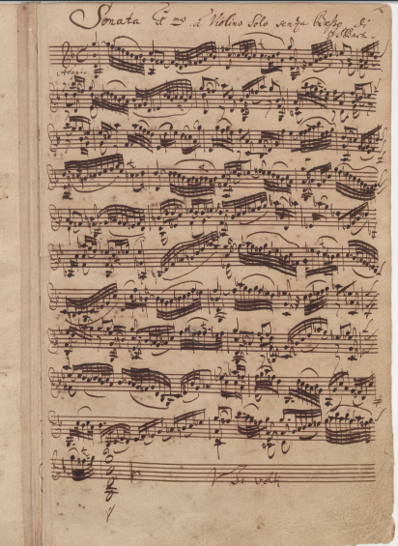
https://www.youtube.com/watch?v=XkZvyA69wCo
Sei Solo a Violino senza Basso accompagnato (Source IMSLP150643) which refers to as the ‘Six Solos for Violin without Bass Accompaniment)
Notes:
Sei Solo a Violino senza Basso accompagnato (Source IMSLP150643) which refers to as the ‘Six Solos for Violin without Bass Accompaniment) and aims to establish and build upon the foundations of violin techniques as a solo instrument.
Sei Solo is also believed to be the incorrect Italian grammar on the title page of the manuscript (instead of Sei Soli) and may be interpreted as ‘You are Alone’, following the death of his wife earlier on that year. Source (A Musicology of Performance: Theory and Method Based on Bach’s Solo for Violin).
Sei = Say
Violino = Vee-o-lino
Accompagnato = Accompag-nyato

Slide 7
Reason of Composition
Some of Bach’s worked prior clearly stated his purpose during the Cothen period. Examples include:
Brandenburg Concertos to Christian Ludwig
Clavier-Buchlein to W. F. Bach
The Well-Tempered Clavier for his sons
The accepted reason of composition suggests that the Solo works were dedicated to the violinist Johann Pisendel of the Dresden Court
However, an underlying composition reason could be in memory of his late wife
Notes:
Some of Bach’s work clearly stated his purpose during the Cothen period.
Examples are: The Brandenburg Concertos to Christian Ludwig, the Clavier-Buchlein for W. F. Bach and the first volume of The Well-Tempered Clavier for his son’s piano study.
A well accepted reason that Bach wrote these pieces were most probably for the violinist Johann Pisendel of Dresden who had studied violin with Corelli and Vivaldi. This is due to the fact that other notable contemporary composers such as Albinoni, Vivaldi and Telemann had already dedicated works to him.
Furthermore, Pisendel had owned a manuscript of the works.
Buchlein = Byu-klein

Slide 8
Musical Structure
Sonatas:
Sonata da chiesa (slow-fast-slow-fast)
1st – Prelude
2nd – Fugue
3rd – Lyrical Movement
4th – Binary Suite (AB or AA’)
Partitas:
Baroque styles: allemande, courante, sarabande, gigue and galanteries
Generally had new elements added in for each new partita
Unorthodox in design compared to other works (example: Telemann Fantasies)
Notes:
The sonatas consist of four movements in the form of the sonata da chiesa (slow-fast-slow-fast).
The first two are in form prelude and fugue respectively, the third being a more lyrical movement and the final being a typical binary suite movement (AB or AA’ form).
The partitas although still making use of the usual baroque elements: allemande, courante, sarabande, gigue and galanteries – each partita had new elements added to provide variety and thus were more unorthodox in design.
Galanteries = Galan-tree

Slide 9
Musical Structure (Continued)
18th Century were more melodic and soloistic (Example: Pictorial violin music – Vivalid’s 4 seasons)
German Violin School was famed for polyphonic playing
Notes:
18th Century violin repertoire was dominated by the Italian school featuring: Corelli, Vivaldi and Tartini.
Music styles became more melodic and soloistic as we can see in Vivaldi’s Four Seasons. Although Bach was certainly influenced by the Italians (such as Bach Double and the Concerto in A Minor), ultimately, his roots still came from the German school which was famed for polyphonic playing.
This was the advanced level technique of making a single solo violin self sufficient in performance without an accompaniment such as a continuo bass.

Slide 10
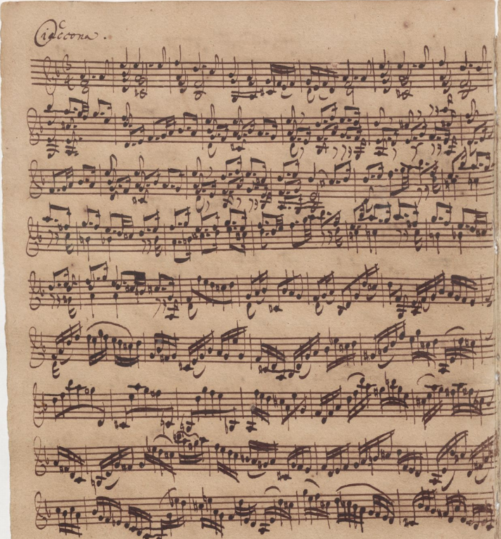
Example of Polyphony:
“Self sustained solo violin performance”

Slide 11
First Performance(s)
Unknown whether or not it was performed within Bach’s lifetime but if so, either Johann Pisendel or Jean-Baptiste Volumier may have been potential performers.
The earliest known performance otherwise took place in 1840 by Ferdinand David (copyist who is thought to have arranged the Vitali Chaconne)
The first partial recording was by Joseph Joachim in 1903
The first full recording by Yehudi Menuhin in 1934
Notes:
It is unknown whether these violin solos were performed during his lifetime and if so, who the performer was.
Scholars speculate that either Johann Pisendel and Jean-Baptiste Volumier who were both talented violinists in the Dresden court could have been possible performers. This is supported by the fact that since Bach himself was an able violinist from his youth, the very detailed autograph manuscript does indicate some fingering for violinists that were to perform this.
The earliest known public performance took place in 1840 by Ferdinand David (who also was a copyist of the Vitali Chaconne) and his edition of the solo was published 3 years later.
the first partial recording by Joseph Joachim in 1903 and the first complete set recorded in 1934 by Yehudi Menuhin.
Joseph Joachim = Yo-seph Yo-a-kim
Yehudi Menuhin = Ye-hu-di Men-u-hin

Slide 12
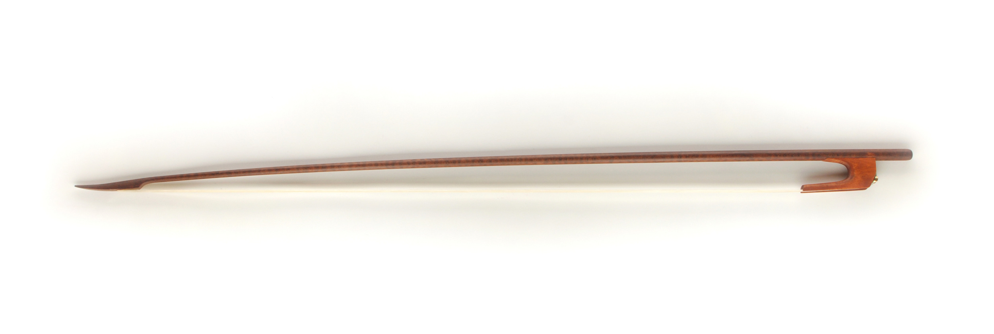
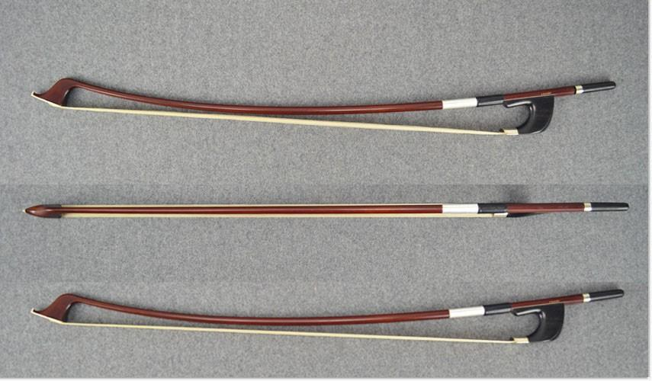
Performance Techniques
18th Century Baroque Bow:
Good for multiple stops
Light touch
Romantic Era Tourte Bow:
Virtuosic Techniques including spiccato and ricochet
More powerful tone
Notes:
Despite a large level of advances in virtuosic playstyle (hello romantic era Paganini) since the Baroque period, the music seemingly still appears to become even more difficult to perform for a modern violinist than that of one in the 18th century.
One main reason could be due to the birth of the Tourte bow – although great for violin techniques such as spicatto and ricochet, was not as great for string crossing and multiple stops.
A way to imagine this could be:
The German violinist of Bach’s day could stretch the hairs tighter or relax them whenever. Chords that the virtuosi of today can only play with difficulty in attempt to give the illusion of multiple stops whereas the German violinist would simply loosen the hairs a little so they curved over the strings.
Tourte = tour-t

Slide 13
Fun Trivia
The rediscovery and obsession with Bach did not stop with Princess Amalia – a well known piece from the Solo Sonatas by the renowned violinist Ysaye directly quotes Bach’s E Major Partita as well as the Gregorian Dies Irae plain chant
Although virtuosic, the movement named “Obsession” only builds upon the ideas of Bach by introducing Romantic era techniques.
https://www.youtube.com/watch?v=Yrtjq1ASpk4
Notes:
The rediscovery and obsession with Bach did not stop with Princess Amalia – a well known piece from the Solo Sonatas by the renowned violinist Ysaye directly quotes Bach’s E Major Partita as well as the Gregorian Dies Irae plain chant.
Although virtuosic, the movement named “Obsession” only builds upon the ideas of Bach by introducing Romantic era techniques.

Slide 14
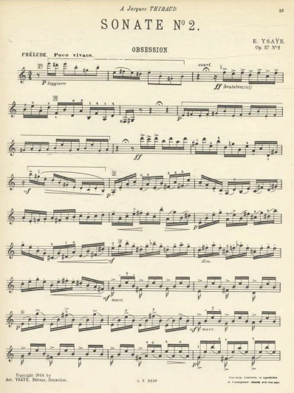
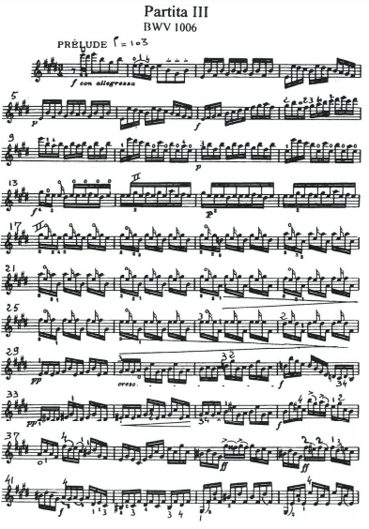

Slide 15
Bibliography
Dorottya, Fabian. A Musicology of Performance: Theory and Method Based on Bach's Solos for Violin.
Exner, Ellen Elizabeth. The Forging of a Golden Age: King Frederick the Great and Music for Berlin, 1732 to 1756. Master's thesis, Harvard University, 2010.
Blanc, Serge, and Enescu, Georges. "Violin Partita No. 3 in E Major.“
Wolff, Christoph. ”Johann Sebastian Bach: The Learned Musician”
IMSLP (Autograph Manuscript, Manuscripts and Editions)

